Slide 1
Compiler Construction

Slide 2
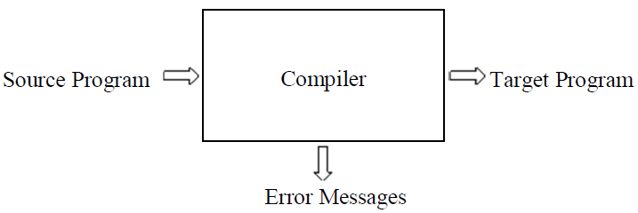
The Structure of a Compiler
A compiler is a program that takes a program written in a source language and translates it into an equivalent program in a target language.
Compiler operates in Phases.
Each phase transforms the source program from one representation into another representation.
Notes:
They communicate with error handlers.
They communicate with the symbol table.

Slide 3
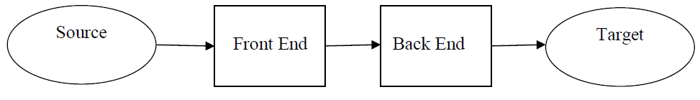
The Structure of a Compiler (contd.)
There are two parts to compilation:
Analysis (front end)
Read the source program and understands its structure and meaning.
Creates an intermediate representation (IR) of the source program.
Synthesis (back end)
Constructs the desired target program from the intermediate representation
Notes:
The first four phases, forms the bulk of the analysis portion of a compiler.
Code Optimization is an optional phase
Synthesis part consists of Code Generator phase.

Slide 4
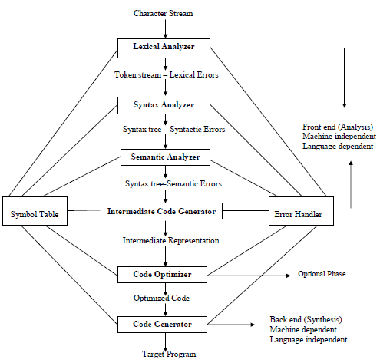
The Structure of a Compiler (contd.)

Slide 5
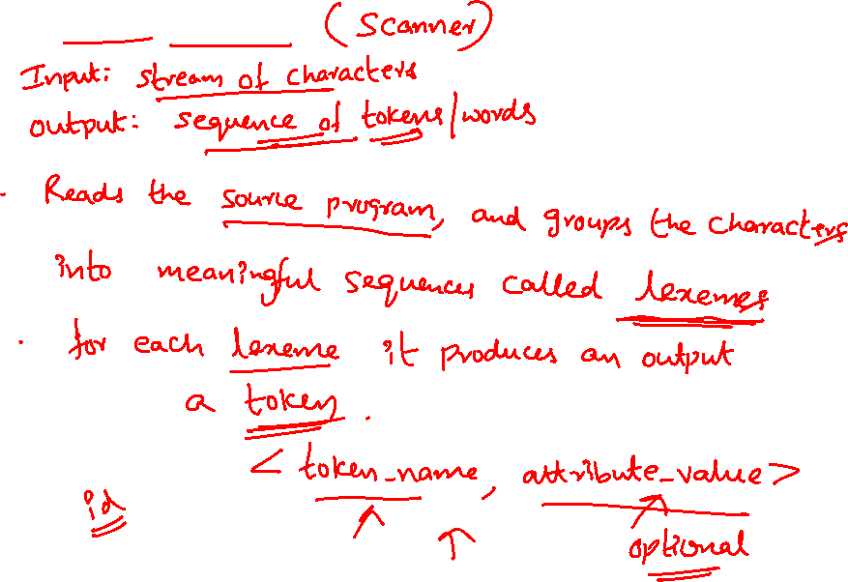
Phase 1: Lexical Analyzer
The Structure of a Compiler (contd.)
Notes:
A character sequence forming a token is called lexeme for the token.
A token describes a pattern of characters having same meaning in the source program. (such as identifiers, operators, keywords, numbers, delimeters and so on)

Slide 6
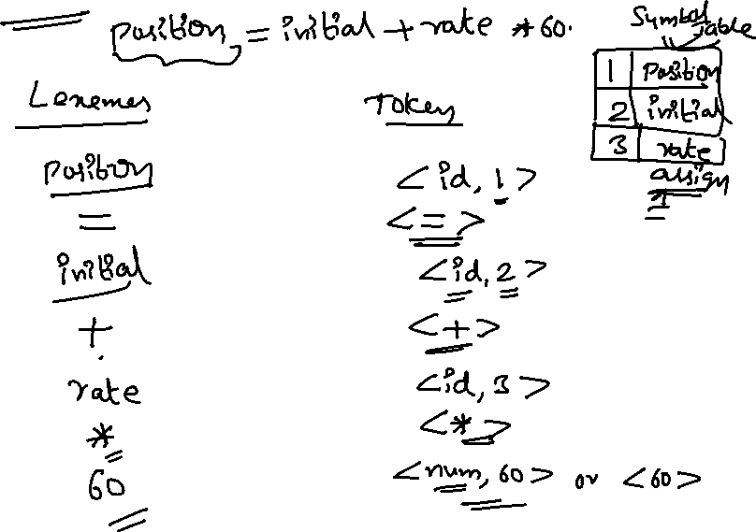
Phase 1: Lexical Analyzer (contd.)
The Structure of a Compiler (contd.)

Slide 7
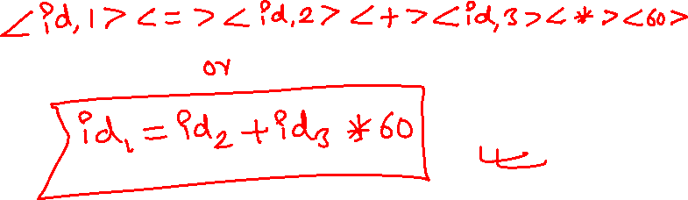
Phase 1: Lexical Analyzer (contd.)
The Structure of a Compiler (contd.)

Slide 8
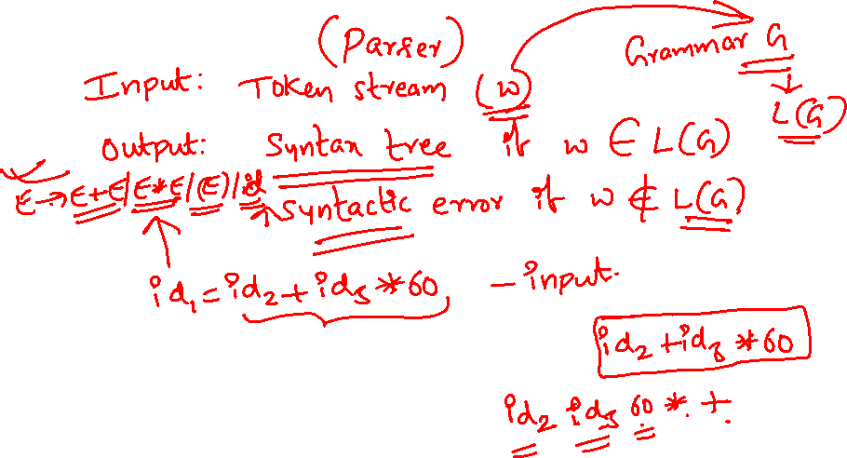
Phase 2: Syntax Analyzer
The Structure of a Compiler (contd.)

Slide 9
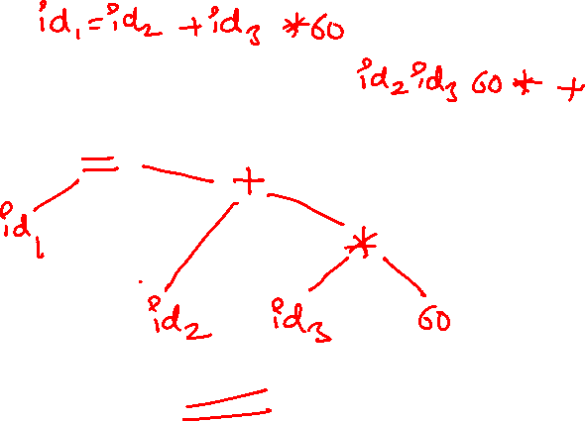
Phase 2: Syntax Analyzer (contd.)
The Structure of a Compiler (contd.)

Slide 10
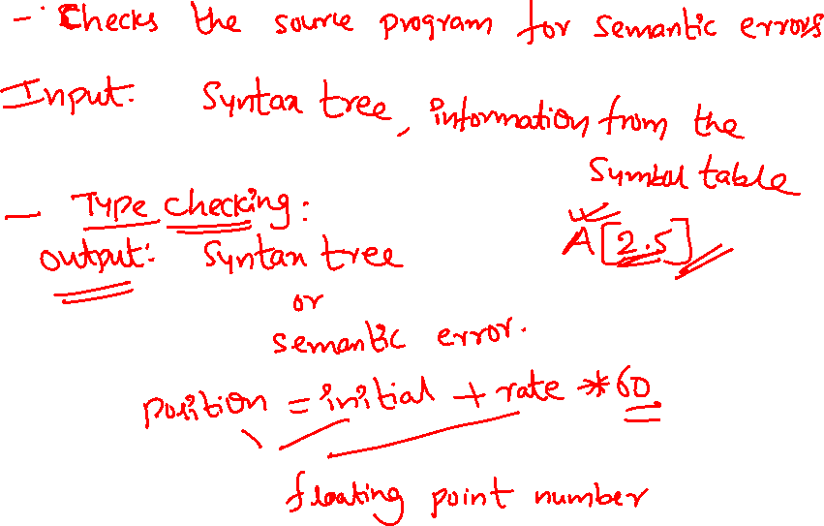
Phase 3: Semantic Analyzer
The Structure of a Compiler (contd.)

Slide 11
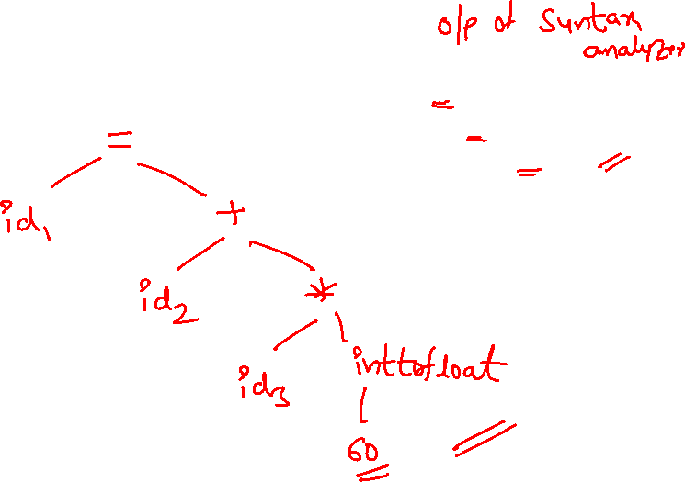
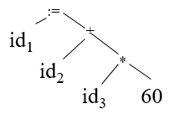
Phase 3: Semantic Analyzer (contd.)
The Structure of a Compiler (contd.)

Slide 12
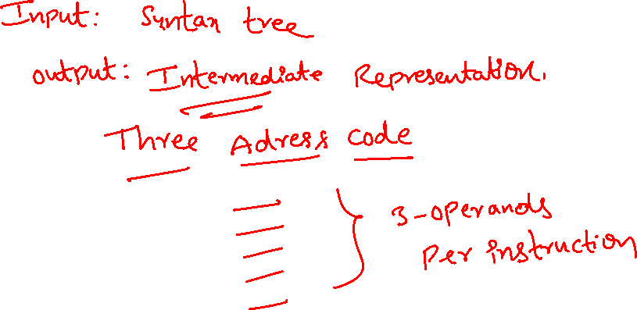
Phase 4: Intermediate Code Generation
The Structure of a Compiler (contd.)

Slide 13
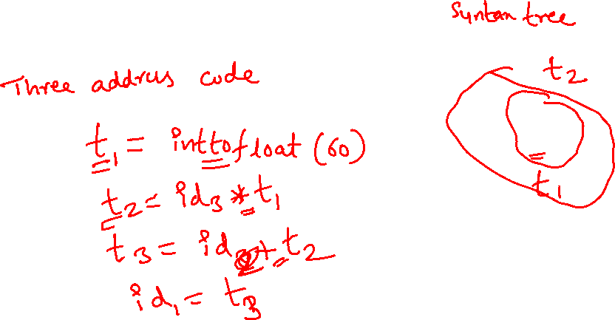
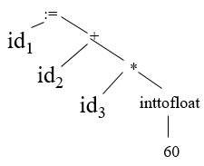
Phase 4: Intermediate Code Generation (contd.)
The Structure of a Compiler (contd.)

Slide 14
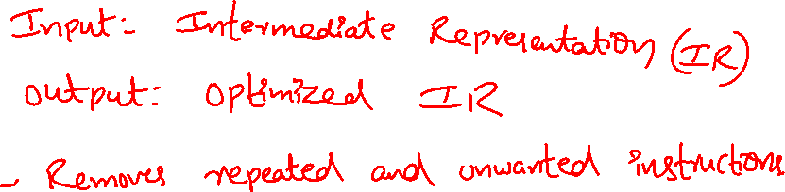
Phase 5: Code Optimizer
The Structure of a Compiler (contd.)

Slide 15
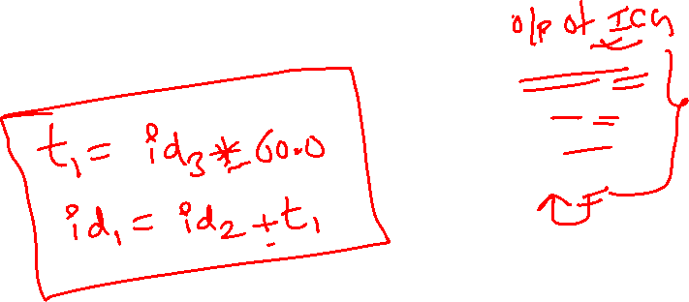
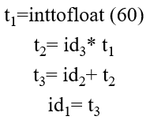
Phase 5: Code Optimizer (contd.)
The Structure of a Compiler (contd.)

Slide 16
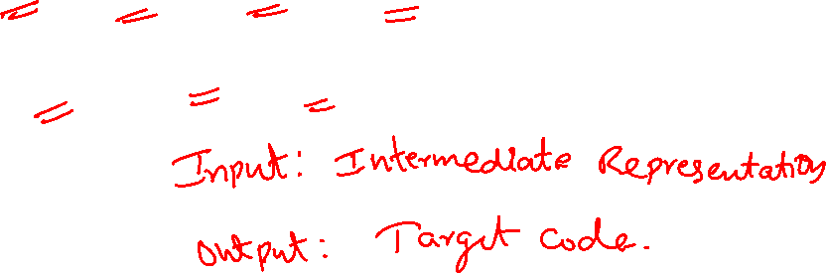
Phase 6: Code Generator
The Structure of a Compiler (contd.)
Code generation is a mapping from source level abstractions to target level abstractions.
Abstractions at the source level:
Identifiers, operators, statements, functions etc.
Abstractions at the target level:
- Memory locations, registers, stacks, opcodes, addressing modes etc.

Slide 17
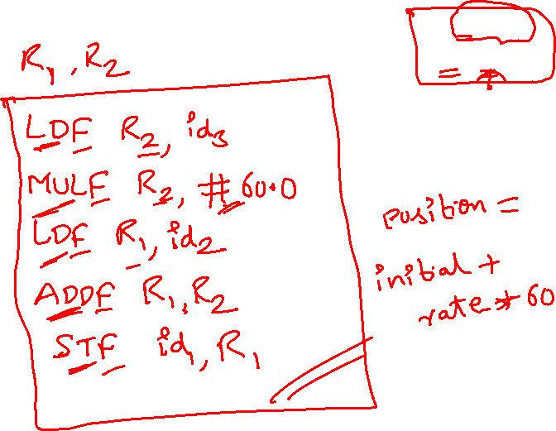

Phase 6: Code Generator
The Structure of a Compiler (contd.)

Slide 18
Reviewing the Entire Process
The Structure of a Compiler (contd.)
position := initial + rate * 60
Lexical Analyzer (Scanner)
id₁ := id₂ + id₃ * 60
Syntax Analyzer (Parser)
:=
id₁
+
id₂
*
id₃
60
Semantic Analyzer
:=
Symbol Table
id₁
+
Error
Handler
id₂
*
1 position ....
2 initial ….
3 rate….
id₃
inttofloat
60
Intermediate Code Generator

Slide 19
Reviewing the Entire Process
The Structure of a Compiler (contd.)
Symbol Table
1 position ....
2 initial ….
3 rate….
Error
Handler
Intermediate Code Generator
t₁ := inttofloat(60)
t₂ := id₃ * t₁
t₃ := id₂ + t₂
id₁ := t₃
Three address code
Code Optimizer
t₁ := id₃ * 60.0
id₁ := id₂ + t₁
Code Generator
LDF R₂, id₃
MULF R₂, #60.0
LDF R₁, id₂
ADDF R₁, R₂
STF id₁, R₁

